Slide 1
Oakville Public Library
Presentation to the Joshua Creek Residents Association
April 29, 2025

Slide 2
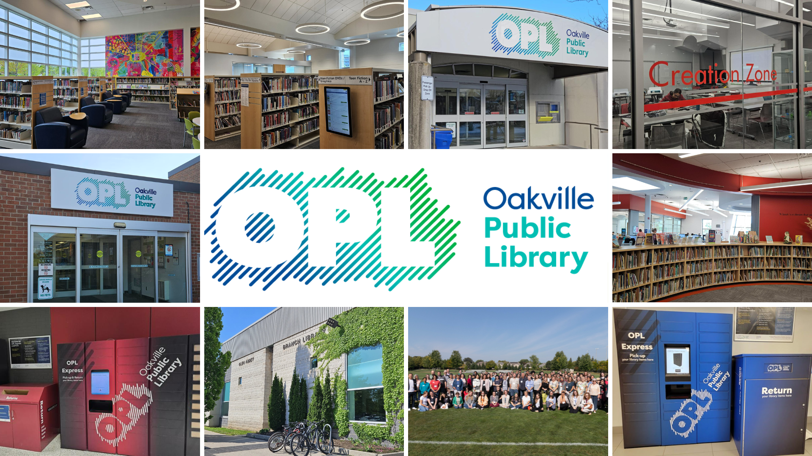
Notes:
OPL has 7 locations: Central Branch – Iroquois Ridge – White Oaks – Sixteen Mile – Glen Abbey – Woodside – Clearview.
140+ staff
1 million items

Slide 3

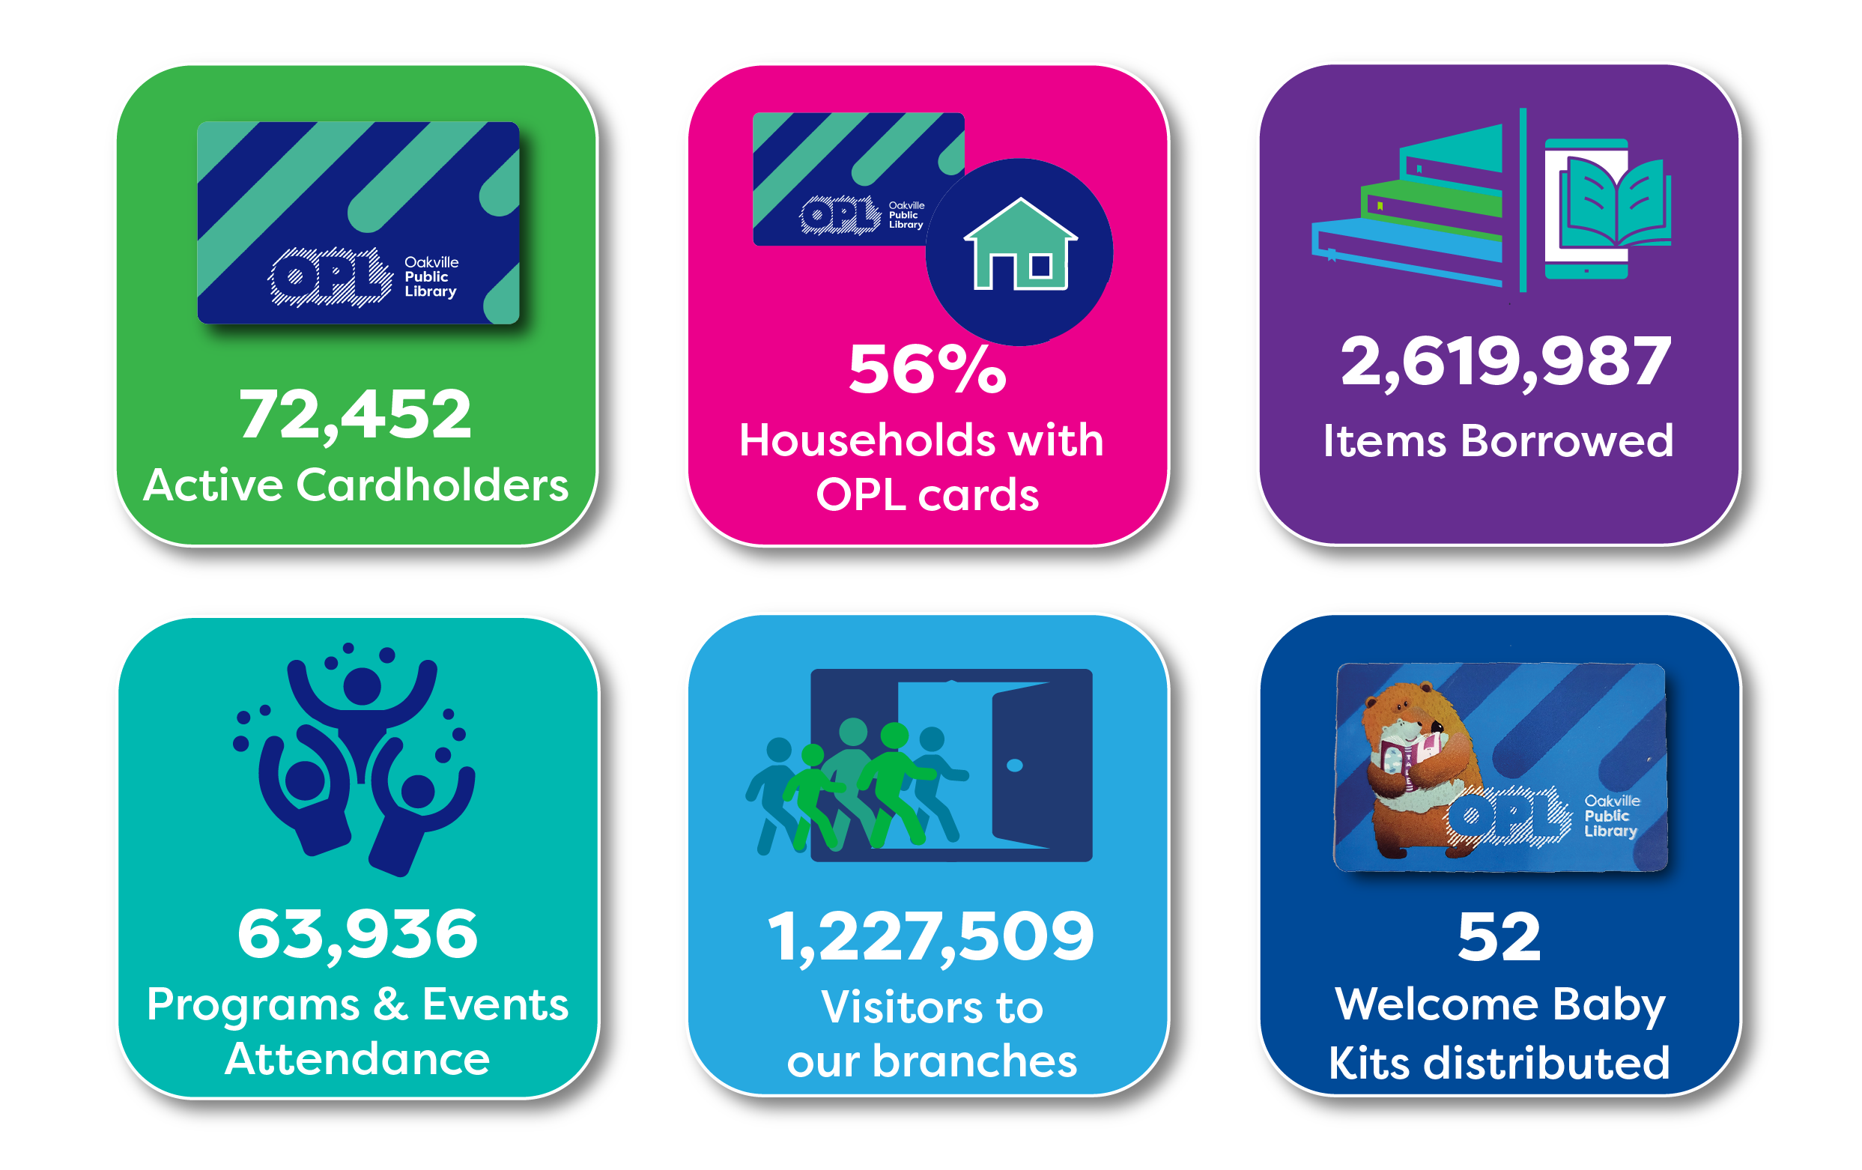
Oakville Public Library: 2024 at a Glance
For 130 years, the Oakville Public Library has been at the heart of our community's learning.

Slide 4
OPL is more just books
Seed Library
Life Jackets
CO2 Monitors
Summer Sports Kits
Winter Sports Kits
Access to LinkedIn Learning
Access to PressDisplay (150+ newspapers)
Storytime Kits
Book Club Kits
Sewing & Serger Machines
Notes:
But OPL is more than just books, over the past 5 year we have expanded our collection to meet the growing demands of residents. This has included adding items like CO2 monitors, snowshoes, Conservation Halton and Ontario park passes.

Slide 5
There is something for everyone
Connections kits (55+)
Memory Stations
Laser Cutter
3D Printers
OPL Picks for You
Book Bikes (OPL on the go!)
StoryWalks at 4 Oakville trails
Community Services Database
Cognitive Care Kits
Grab and Go Bags
Food Shelves (including pet food)
Notes:
Whether it's our Grab and Go bags which have curated books by age/topic for you to pick up on the go or cognitive care kits designed in partnership with Acclaim Health, OPL has something to support the interests and needs of you and your family,

Slide 6
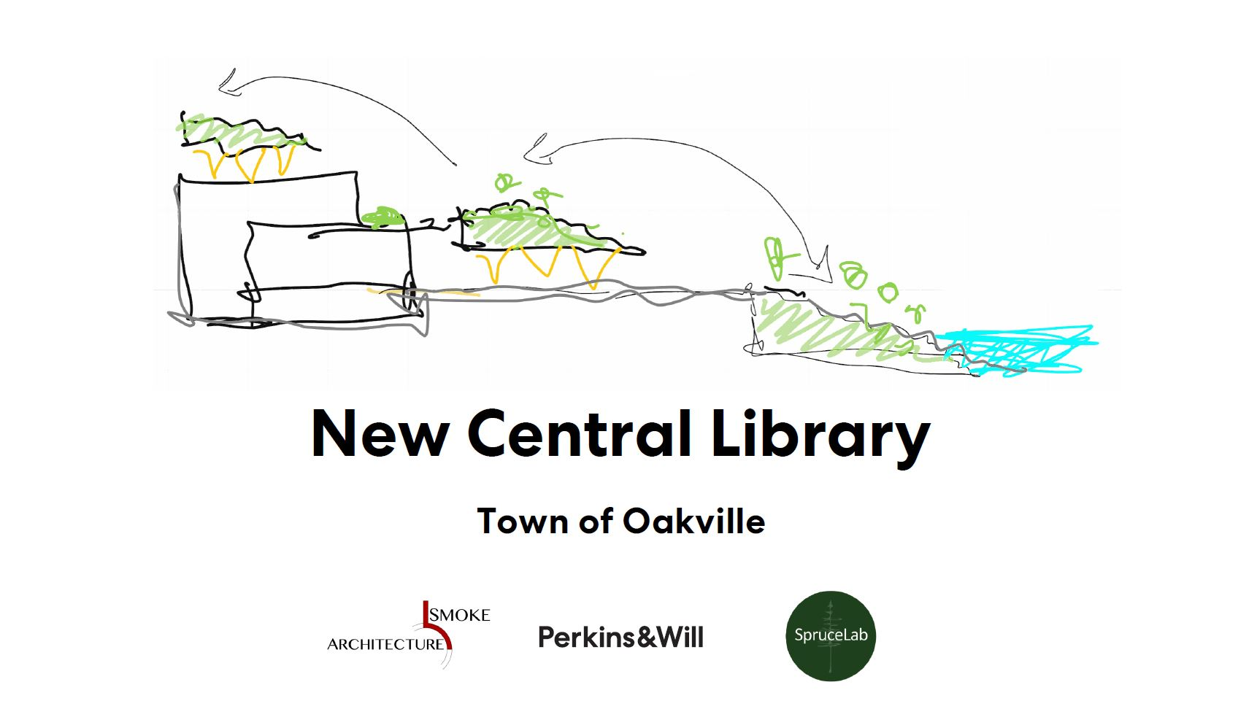
Notes:
Now on to the what I suspect holds the most interest for the association. As you likely have heard, OPL and the Town of Oakville have started the process to build a new Central branch.

Slide 7
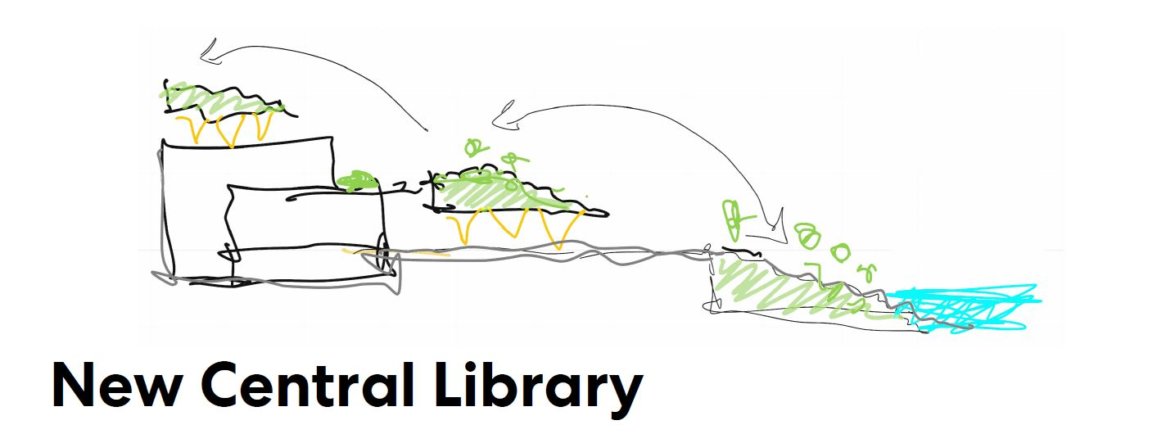
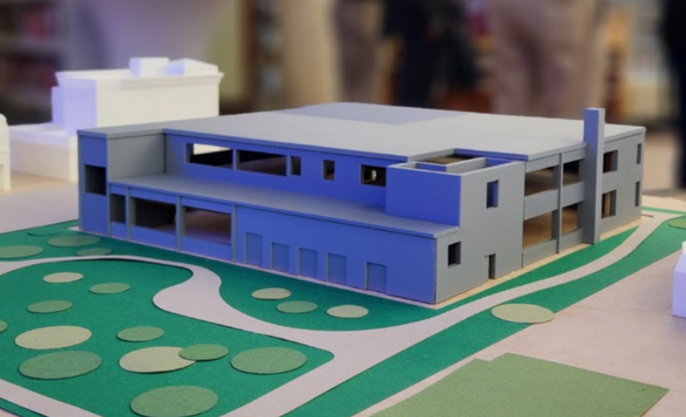
New Central Branch Project 2024-2028
Project Goal: To design a new facility that honours the past while building for the future at 193 Church Street.​
Interim: The current Central Branch will continue serving the community until the new facility is open. ​
Campaign: Started early 2024 to create opportunities outside the current project scope like roof-top gardens, a living wall, Truth and Reconciliation spaces, etc.
How is a river like a letter?
Conceptual drawing only
Notes:
40-million-dollar project to build a new Central branch to match the current service levels. However, the new build presents endless possibilities and opportunities to expand services.

Slide 8
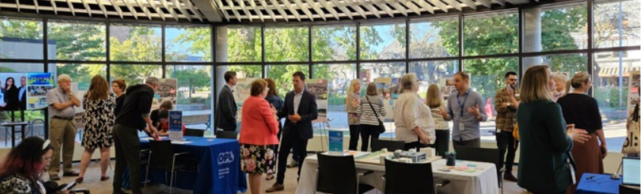
Public Engagement
To ensure this space reflects the needs and aspirations of the Oakville community, OPL invited residents to share their ideas through a public survey and engagement sessions, held in the fall 2024.

Slide 9
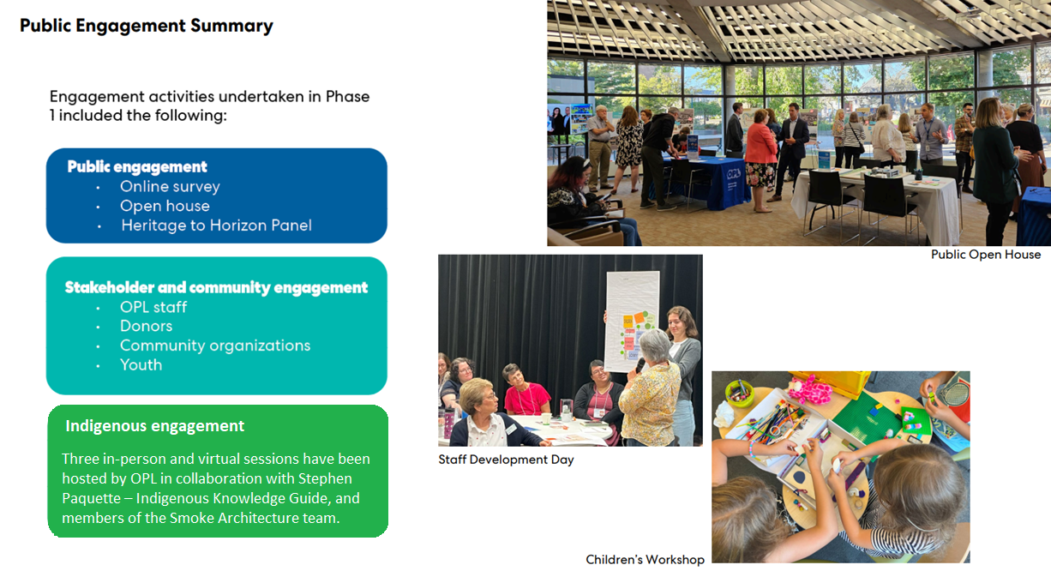
Engagement Activities
Engagement Activities
Conceptual drawing only
Notes:
OPL held the initial portion of its public engagement throughout September into October with a public survey, open house, stakeholder sessions as well as multiple programs for kids and teens to design their dream library. Indigenous engagement took place in October into December. Both the Public Engagement and Indigenous Engagement Reports are available to review on the New Central page at opl.ca.

Slide 10
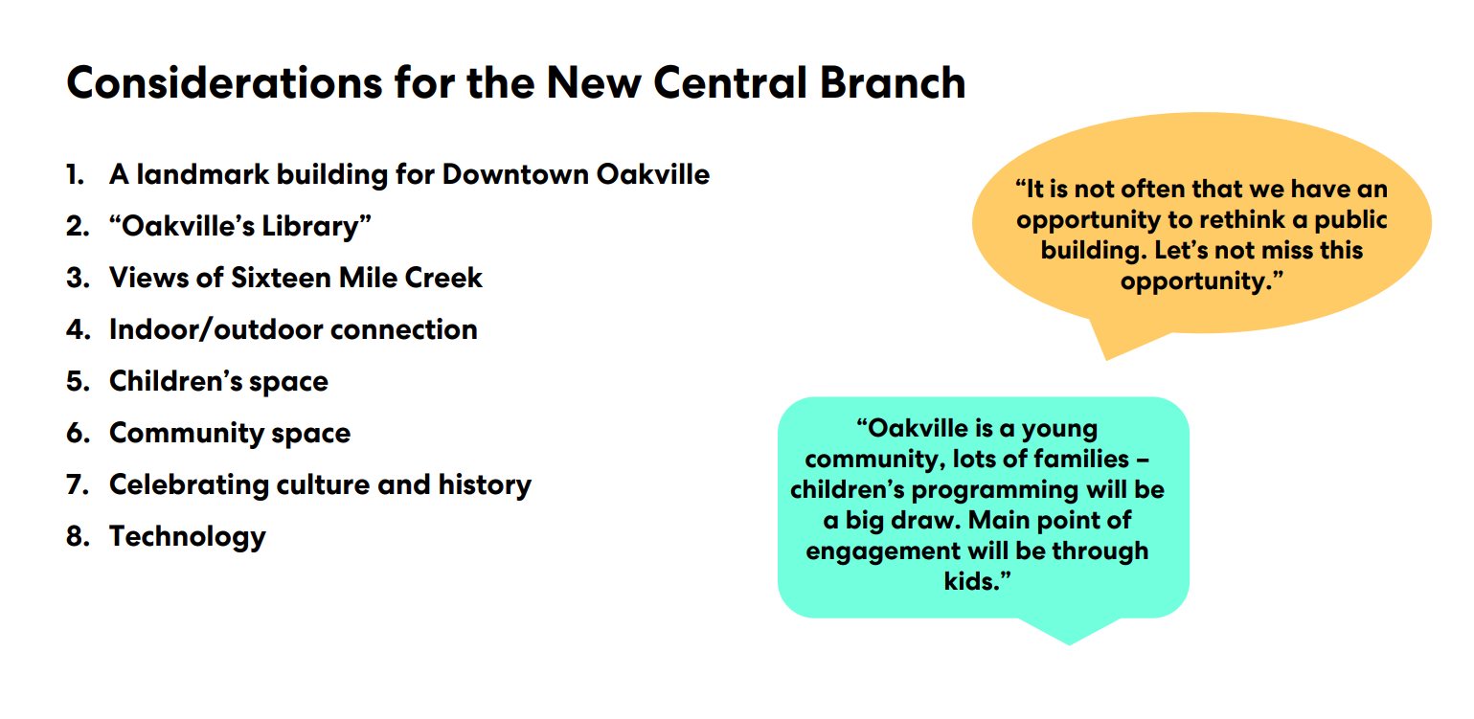
Public Engagement Key Considerations
1. A landmark building for Downtown Oakville.
2. “Oakville’s Library.”
3. Views of Sixteen Mile Creek.
4. Children’s space.
5. Indoor/outdoor connection.
6. Community space.
7. Celebrating culture and history.
8. Technology.
Notes:
From the public consultation came the following 8 considerations. These, along with any considerations emerging from the indigenous consultation will inform Perkins&Will as they create the design of the new building.
A landmark building for Downtown Oakville. People are excited by the opportunity for a major new public building in Downtown Oakville and would like to see the historic post office building reinvented as a landmark within the Downtown.
“Oakville’s Library.” Central Branch has a special place within Oakville Public Library and should be a destination that draws and connects people from across Oakville. It should be a space where everyone sees themselves in the design and feels welcome and comfortable.
Views of Sixteen Mile Creek. People are excited by the site itself and the potential to take advantage of views of Sixteen Mile Creek, possibly through an addition.
Children’s space. Everyone agreed that the new library should include a spectacular children’s area with a variety of facilities designed for kids.
Indoor/outdoor connection. Outdoor spaces of all types were a repeating theme in the engagement feedback. This includes everything from large festival and event spaces to cozy, shaded outdoor reading rooms. Bringing the outside in with large windows and plants was another desire.
Community space. Community organizations in Oakville are in need of all kinds of spaces, from a large auditorium for special events to affordable large meeting rooms for groups of up to 100 to small bookable meeting rooms and work spaces.
Celebrating culture and history. The new Central Branch should be a place to share and celebrate Oakville’s culture and history. This includes the history, culture and knowledge of Indigenous Peoples who have inhabited the land for millennia and more recent archives and records of the Town of Oakville.
Technology. The library is where people go to access technology and they are looking for everything from a simple reliable internet connection to 3D

Slide 11
“The building
must be a tool
for teaching,
in its special features
and in its architectural elements”
- Indigenous Engagement Summary Report
Indigenous Engagement Key Considerations
The Indigenous engagement process not only guided and inspired the design team but also created valuable opportunities for sharing and building trust.
Indigenous Engagement Summary Report is available for review at opl.ca
1. Accessible indoor & outdoor gathering spaces
2. Fostering connections to the land and waterways
2. Heritage space reflecting Oakville’s Indigenous history
3. Space for Indigenous Knowledge Guide
4. Space for Indigenous art and live performances
5. Space for preparing, cooking, and eating food
Notes:
From the public consultation came the following 8 considerations. These, along with any considerations emerging from the indigenous consultation will inform Perkins&Will as they create the design of the new building.
A landmark building for Downtown Oakville. People are excited by the opportunity for a major new public building in Downtown Oakville and would like to see the historic post office building reinvented as a landmark within the Downtown.
“Oakville’s Library.” Central Branch has a special place within Oakville Public Library and should be a destination that draws and connects people from across Oakville. It should be a space where everyone sees themselves in the design and feels welcome and comfortable.
Views of Sixteen Mile Creek. People are excited by the site itself and the potential to take advantage of views of Sixteen Mile Creek, possibly through an addition.
Children’s space. Everyone agreed that the new library should include a spectacular children’s area with a variety of facilities designed for kids.
Indoor/outdoor connection. Outdoor spaces of all types were a repeating theme in the engagement feedback. This includes everything from large festival and event spaces to cozy, shaded outdoor reading rooms. Bringing the outside in with large windows and plants was another desire.
Community space. Community organizations in Oakville are in need of all kinds of spaces, from a large auditorium for special events to affordable large meeting rooms for groups of up to 100 to small bookable meeting rooms and work spaces.
Celebrating culture and history. The new Central Branch should be a place to share and celebrate Oakville’s culture and history. This includes the history, culture and knowledge of Indigenous Peoples who have inhabited the land for millennia and more recent archives and records of the Town of Oakville.
Technology. The library is where people go to access technology and they are looking for everything from a simple reliable internet connection to 3D printing

Slide 12
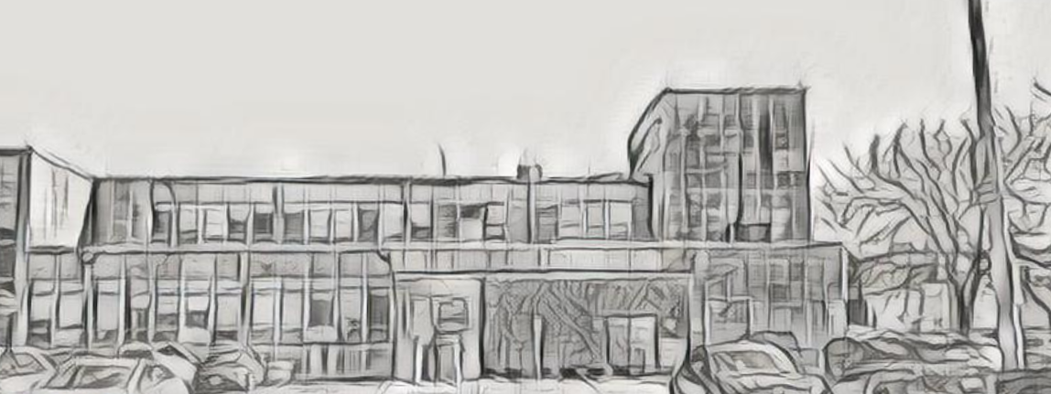
Structural Review
To assess the facility’s ability to support the Library’s requirements
and public engagement key considerations

Slide 13
Timeline
Sep – Oct 2024
Initial Public Consultation
Oct – Dec 2024
Indigenous Consultation
Nov 2024 – May 2025
Preliminary concept design
Jun – Sep 2025
Detailed Design
Jun – Dec 2025
2025 Budget
2026 – 2028
Construction
2028
opening
Notes:
With a target opening date in late 2028, the timeline presented here highlights the major milestones. Each milestone will have a consultation piece to help validate the direction of the project. The next consultation touchpoint is expected in Q2 once a concept design has emerged. OPL’s CEO Tara Wong will continue to connect in with the resident associations at the consultation touchpoints to ensure that you can provide feedback for that stage.

Slide 14
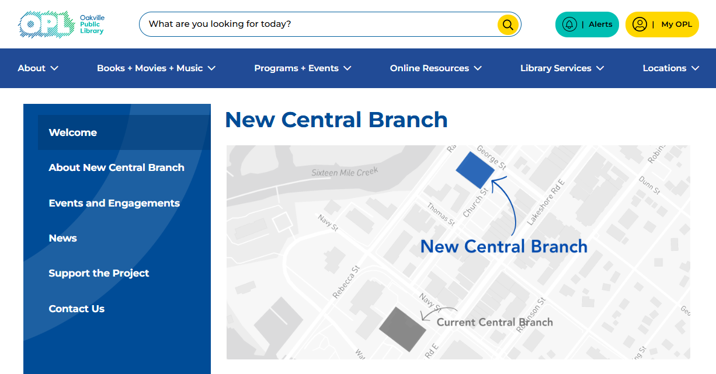
Stay Connected opl.ca/NewCentral
Notes:
Once we conclude the structural review, we will look to finalize the draft design concepts and start another round of public engagement, aimed at determining whether the concepts accurately reflect the feedback provided during the initial round of engagement. Following any tweaks to the concepts, we would then move into the detailed design phase of the project.
Residents will be able to stay involved and find updates on our New Central page on opl.ca. They can also sign up to receive update emails directly.

Slide 15
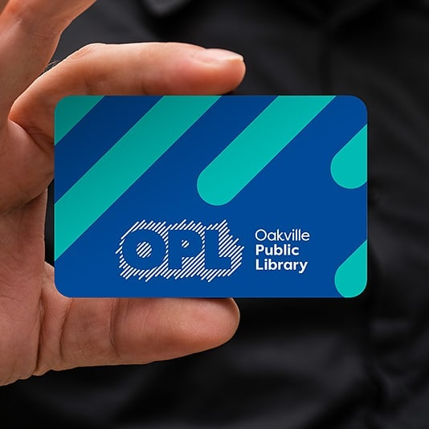
Thank You!

