Slide 1
JCRA Feedback on the 560 and 772 Winston Churchill Blvd. submissions to the Town of Oakville
Comments from the Joshua Creek Resident’s Association on the Applicant’s Re-submission in response to Town of Oakville requirements for Ultimate Operating Condition Analysis of both 560 & 772 Winston Churchill Blvd
March 2024

Slide 2
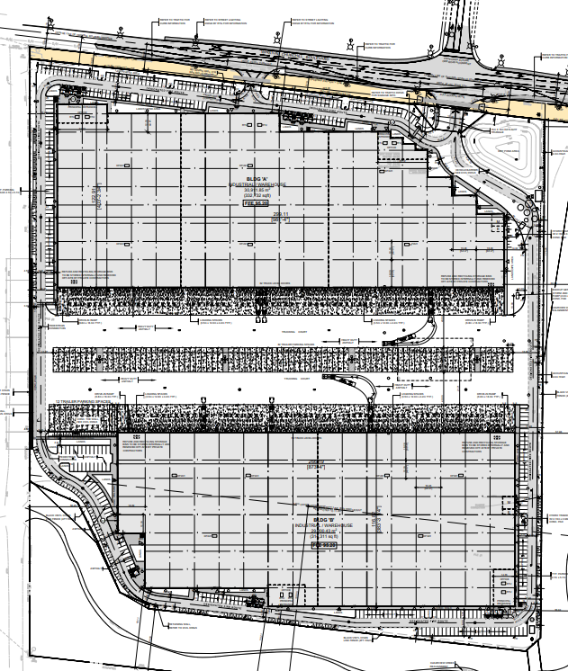
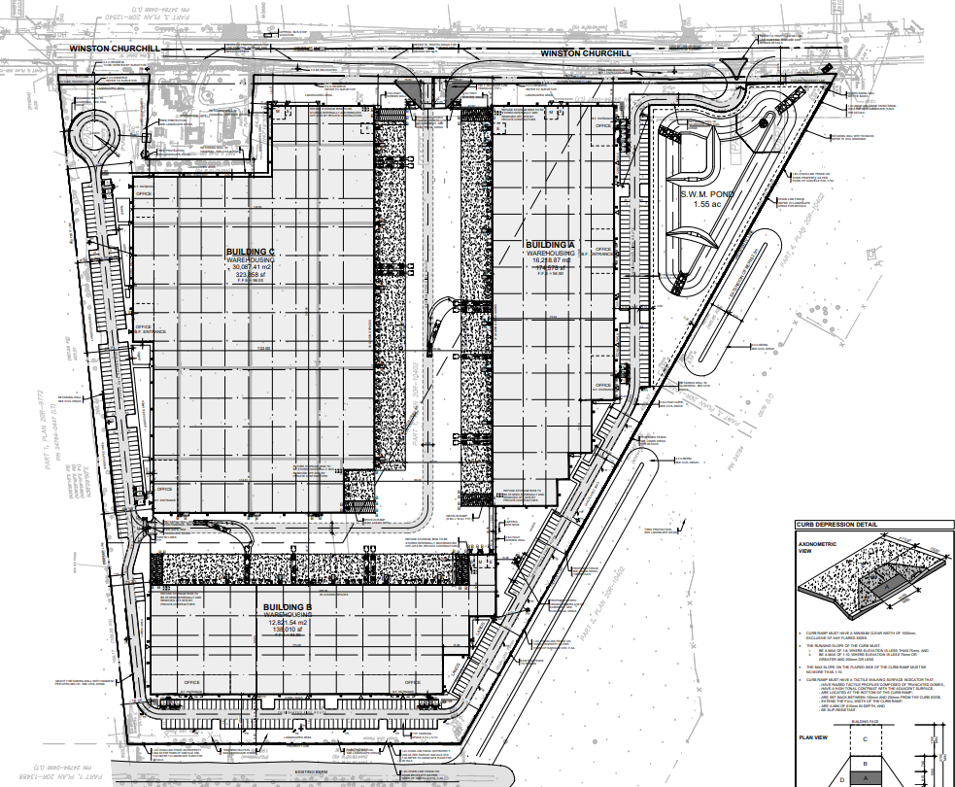
772 + 560 WCB = 70.5 acres ; a total 1.3 million SF of warehouse space, 725 employee parking spaces, 226 Loading Docks, 94 Tractor Trailer Parking Spaces adjacent to a > 30+ year old residential neighbourhood.
Winston Churchill Blvd.
CN Rail Spur LIne
Deerhurst Residents
Aspen Forest Park, Claremont and Acacia Court Residents

Slide 3
560 Winston Churchill Blvd. – 636,446 SF
Should be a solid acoustic wall
387 employee parking spaces around perimeter
Bldg. A 36’
772 WCB
Bldg. C 44.3’
Deerhurst Residents
Add should be
a solid acoustic wall
Noise wall now referred to as Screen wall ??
116 Loading Docks
Bldg. B 36’
Chain link fencing should be changed to a solid acoustic wall
Claremont & Acacia Court Residents

Slide 4
772 Winston Churchill Blvd. – 647,043 SF
338 Employees Parking Spaces – around perimeter
Bldg. A
43.3’ Height
560 WCB
Rail Tracks
Parking for 94 trailers + 110 Loading Docks
Gap in noise wall ?
Bldg. B 36” Height
Change Chain Link fence to a solid fence/acoustic barrier
Change chain link fence to solid fence/acoustic barrier
Claremont Residents

Slide 5
Site Statistics January 2024 – 560 Winston Churchill Blvd.

Slide 6
Site Statistics January 2024– 772 Winston Churchill Blvd.

